Slide 1
Capture the flag
COMP2003 – Computing Group Project
Group 6

Slide 2
What is Capture the flag?
What will this presentation entail?

Slide 3
Overview of Project and Aims
Online, team-based educational game
Designed for classroom and outreach environments
Encourages engagement through competition
Learning content delivered through questions and mini-games

Slide 4
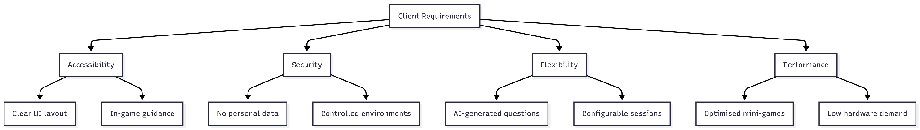
Core Requirements
Accessible and intuitive (no prior training required)
Secure and private (suitable for minors)
Flexible for different subjects and class sizes
Smooth performance on low-spec school hardware
Minimal data storage

Slide 5
Proposed Game Flow (How the game works)
Two (or more) teams compete in timed rounds
Answer questions and complete mini-games to earn points
AI-generated challenges add variety and adaptability
Optional mini-games provide bonuses or penalties
Teachers can manage sessions and content

Slide 6
Questionnaires & AI Integration
Core learning delivered through questionnaires
Questions generated using an AI model
Educators can refine or customise questions
Supports multiple subjects and difficulty levels
Allows adaptability across different classes

Slide 7
Mini-Games System
Designed to: - Reward correct answers - Provide bonus points
Apply temporary advantages or penalties
Keeps students engaged and competitive
Mini-games are intentionally small to ensure smooth performance

Slide 8
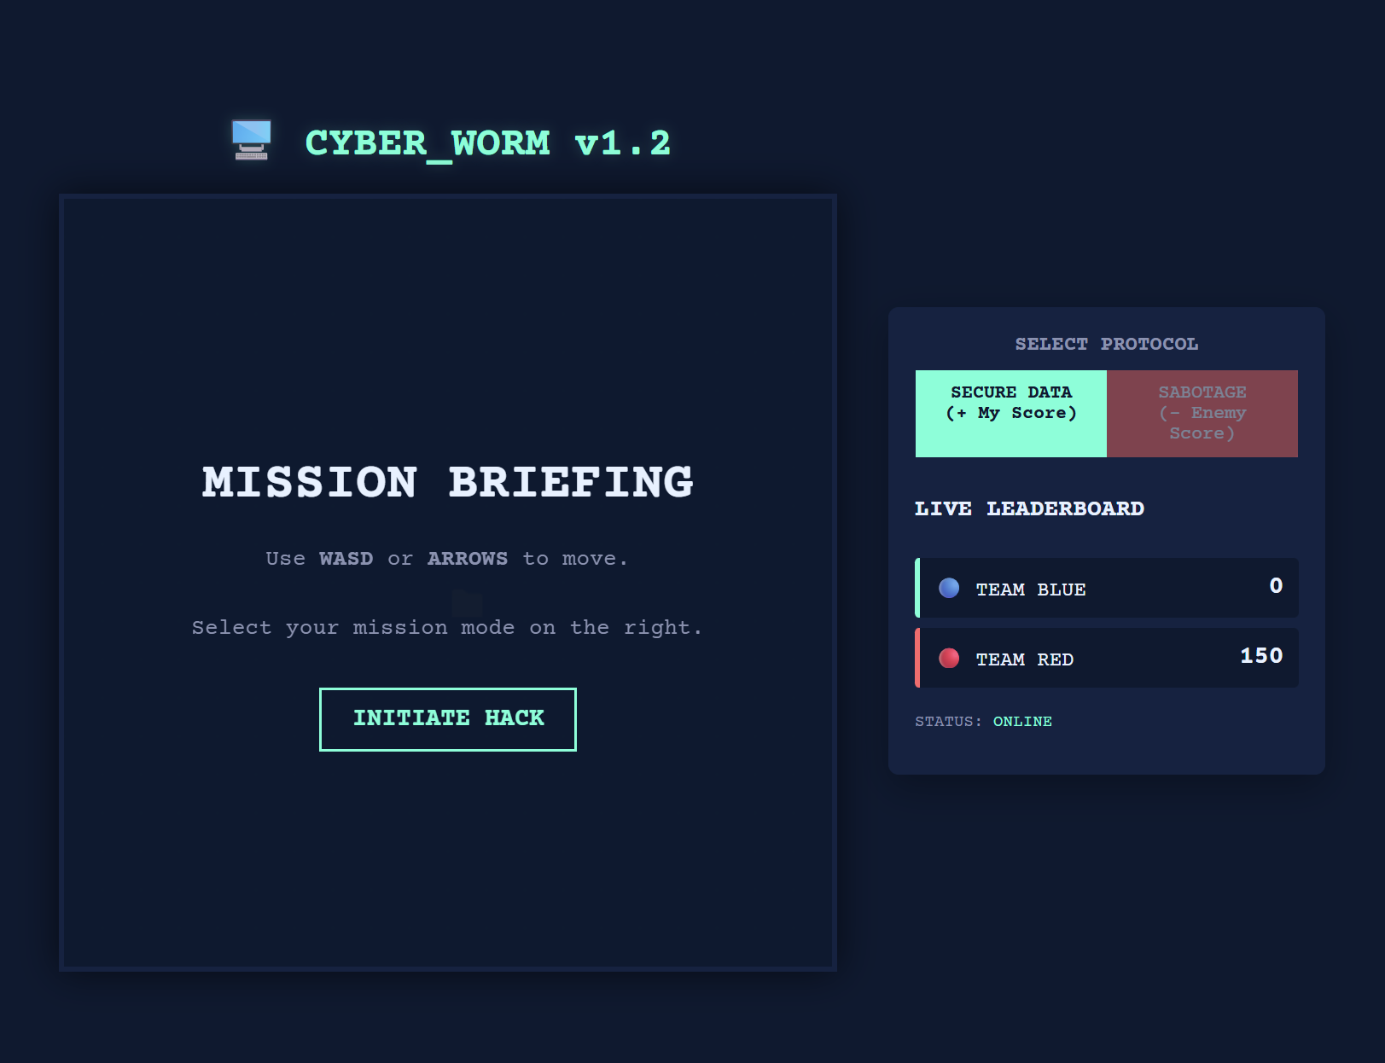
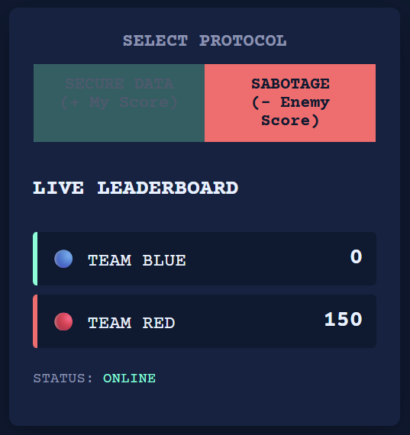
Mini Game Example:
Cyber Worm is a grid-based, snake-style mini-game designed to reinforce learning through interactive gameplay.

Slide 9
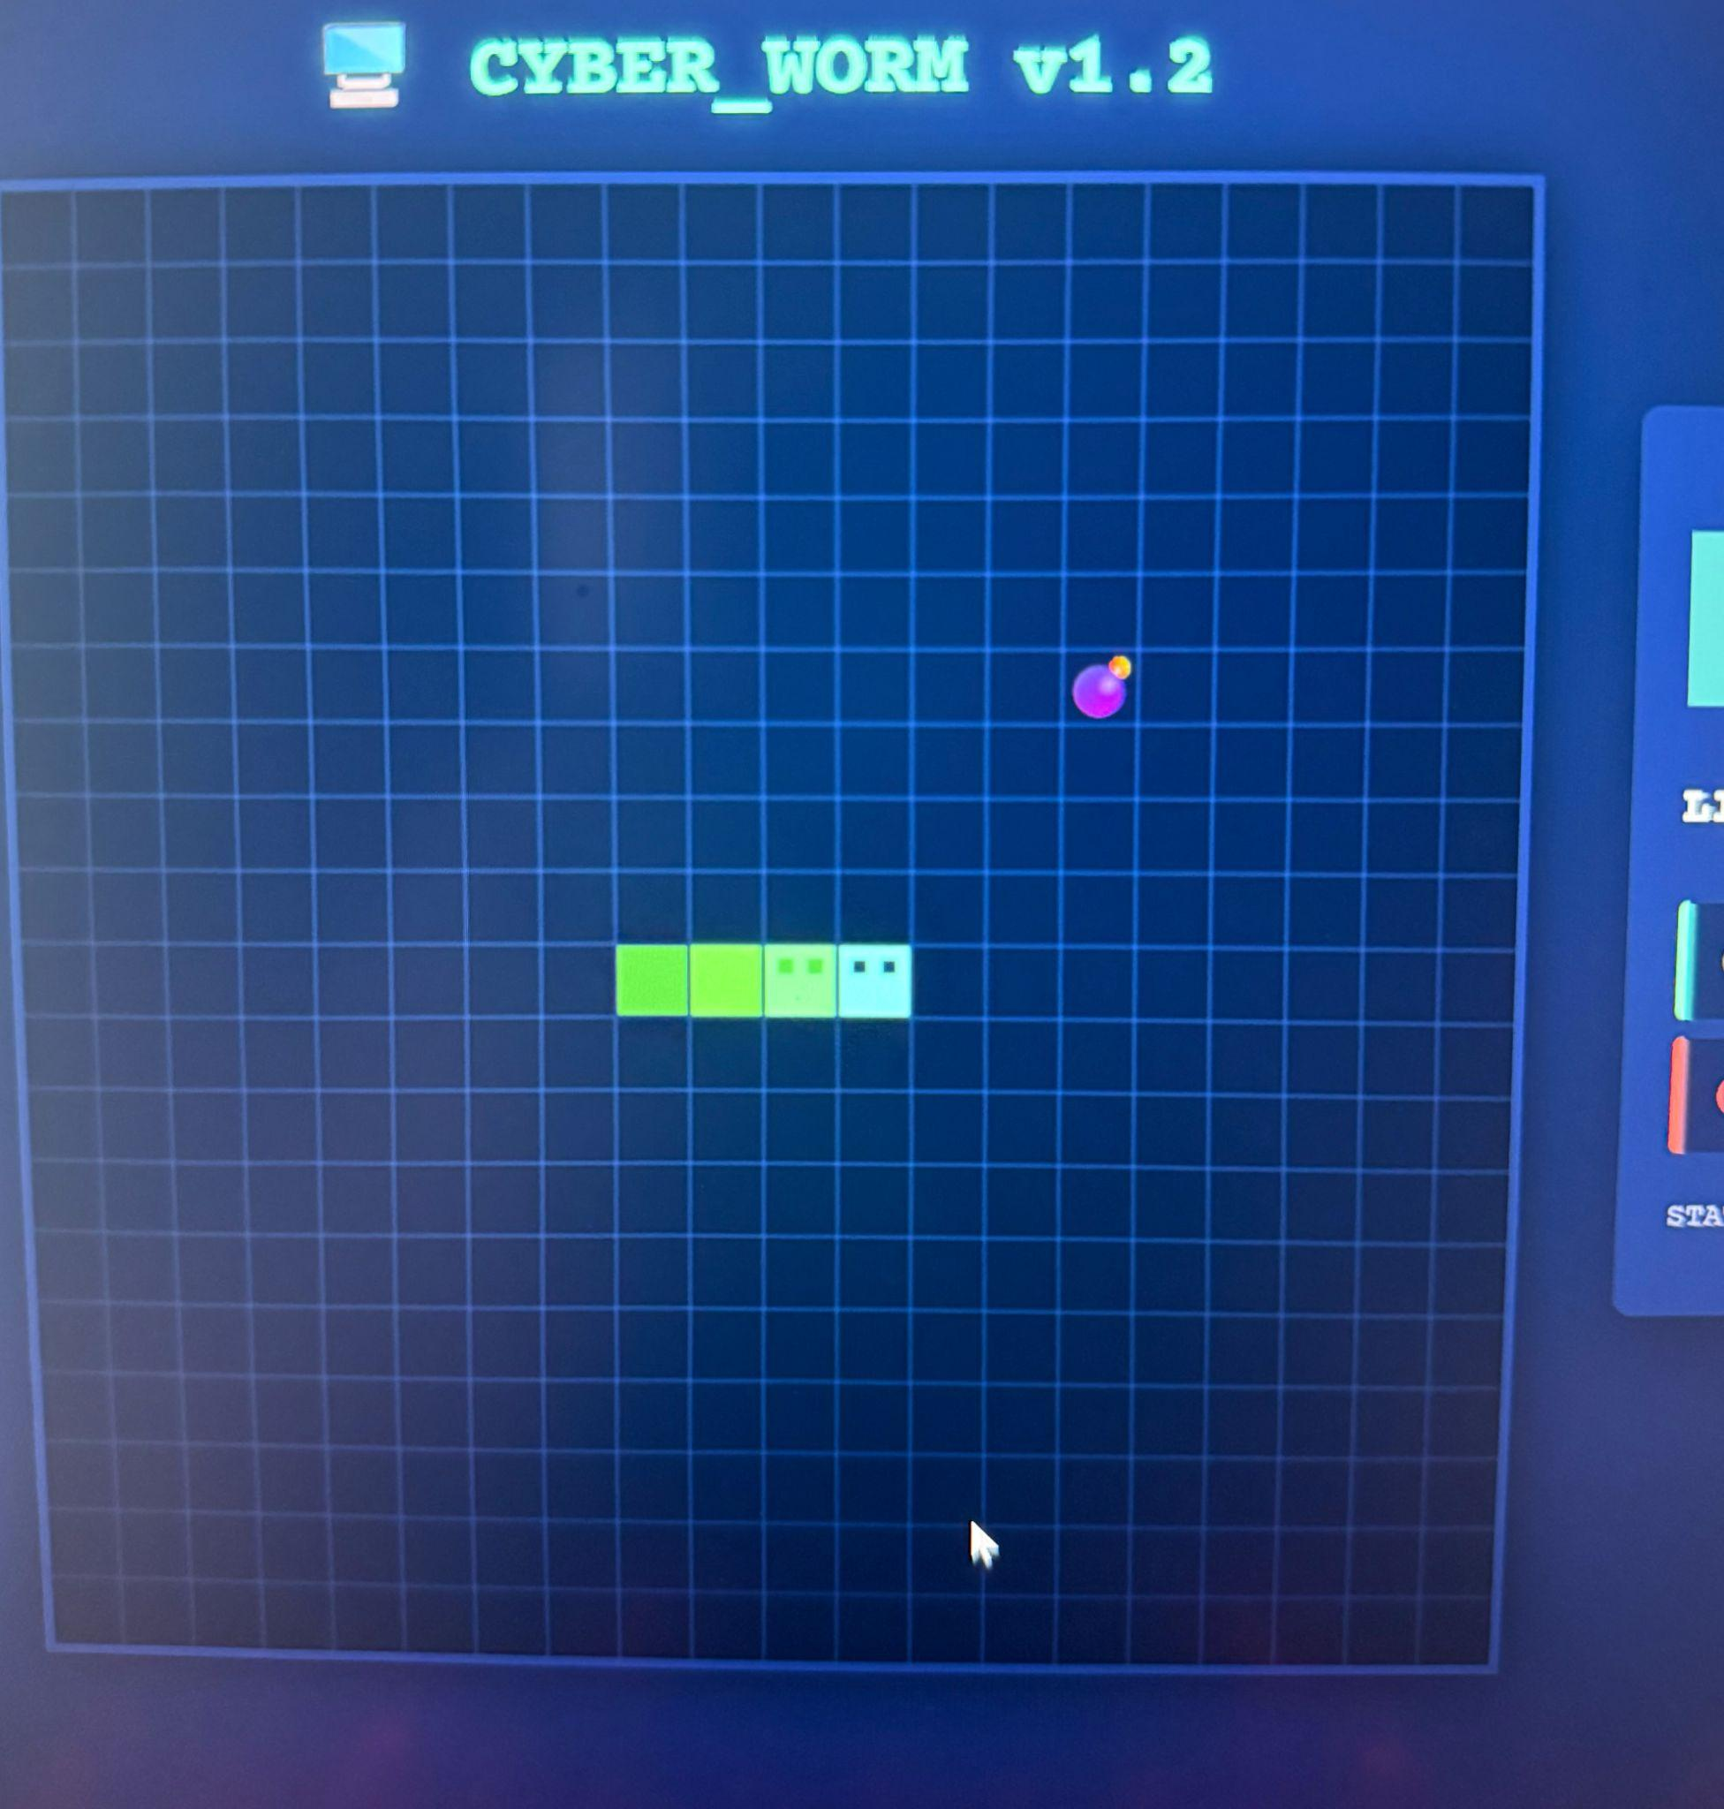
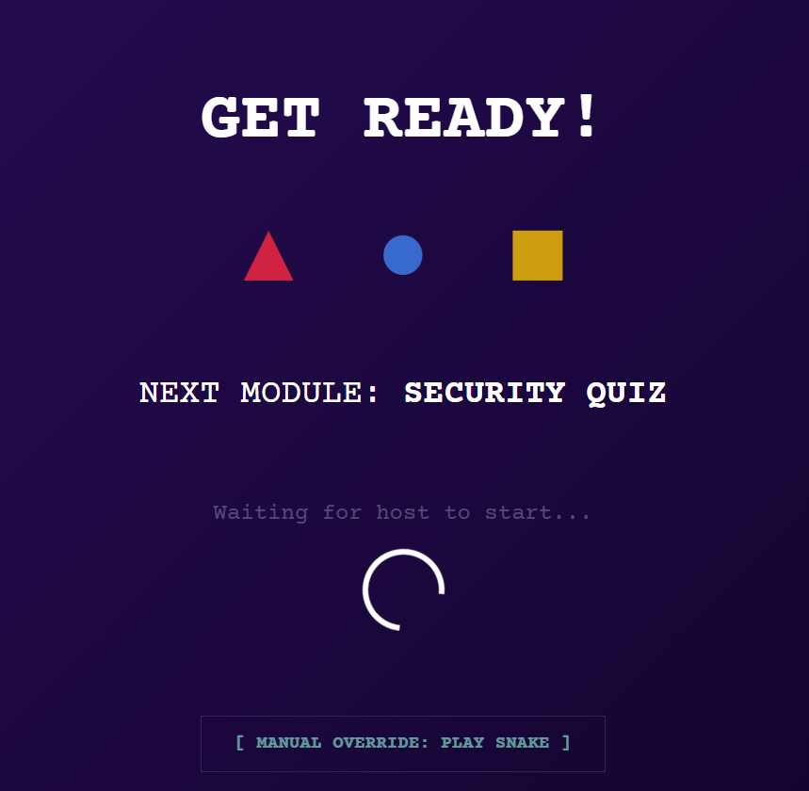
It is integrated into the Capture the Flag system as a short challenge that appears between questionnaire rounds, where player performance can influence team scores or provide temporary advantages.

Slide 10

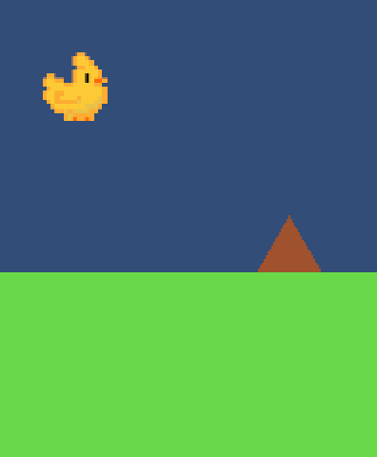
Jumper Mini Game:
Jumper is a time score-based game requiring you, the player, to avoid incoming obstacles.
Thematically, this will be on theme with our other mini games. Assets are currently placeholders

Slide 11
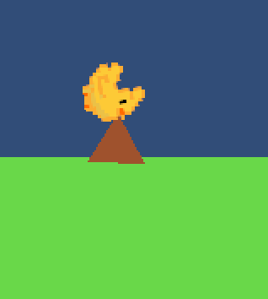
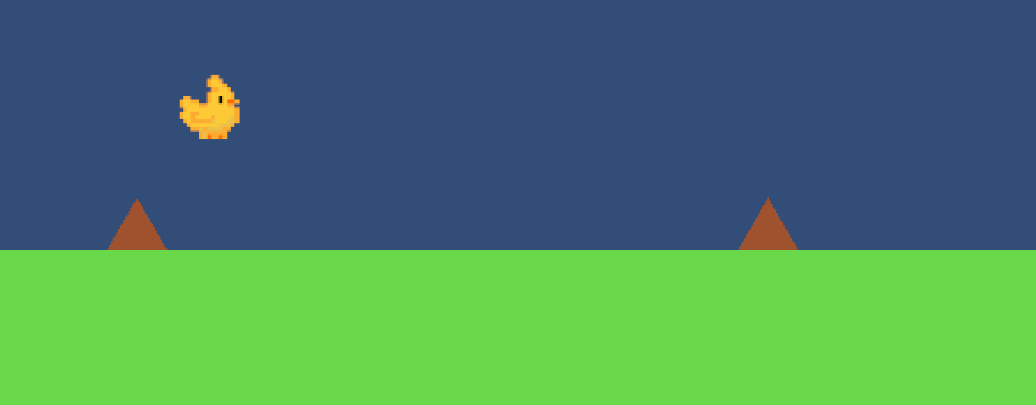
As the game progresses, the difficulty will steadily increase. Becoming a test of reaction times and quick thinking
The game will conclude upon collision with an obstacle

Slide 12
UI Design (Initial Concept)
Early low-fidelity UI prototype
Focused on: - Team separation - Score visibility - Leaderboard clarity
Designed to explore layout and information hierarchy
Not tied to final implementation

Slide 13
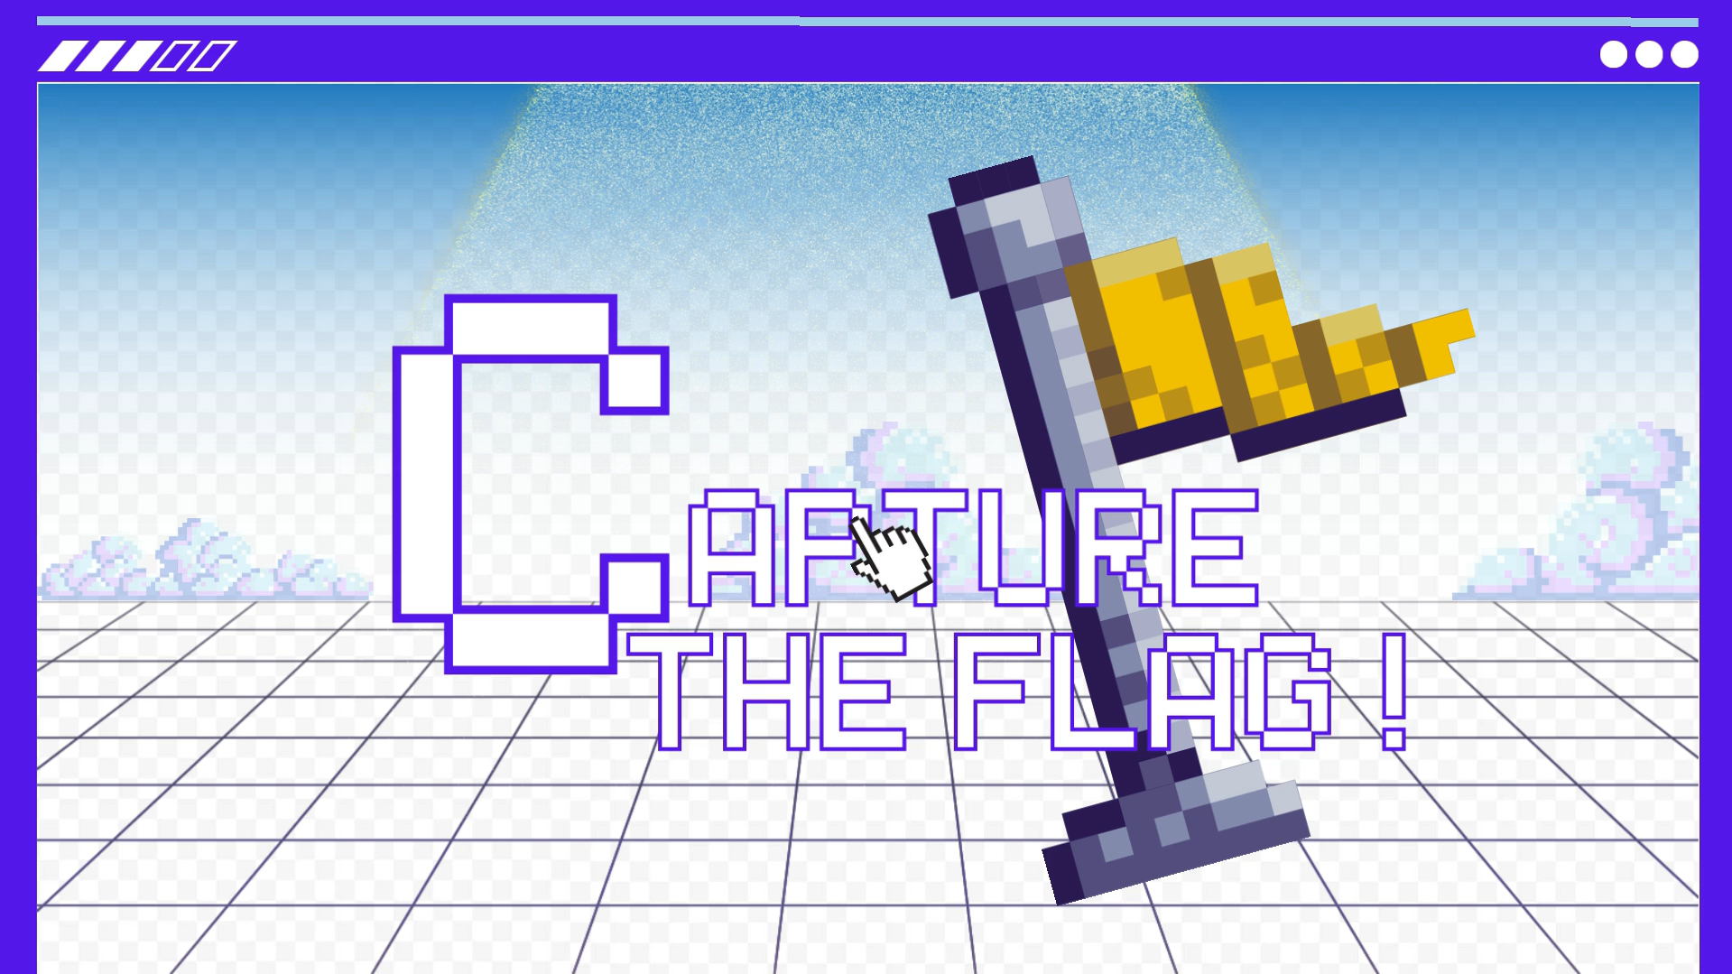
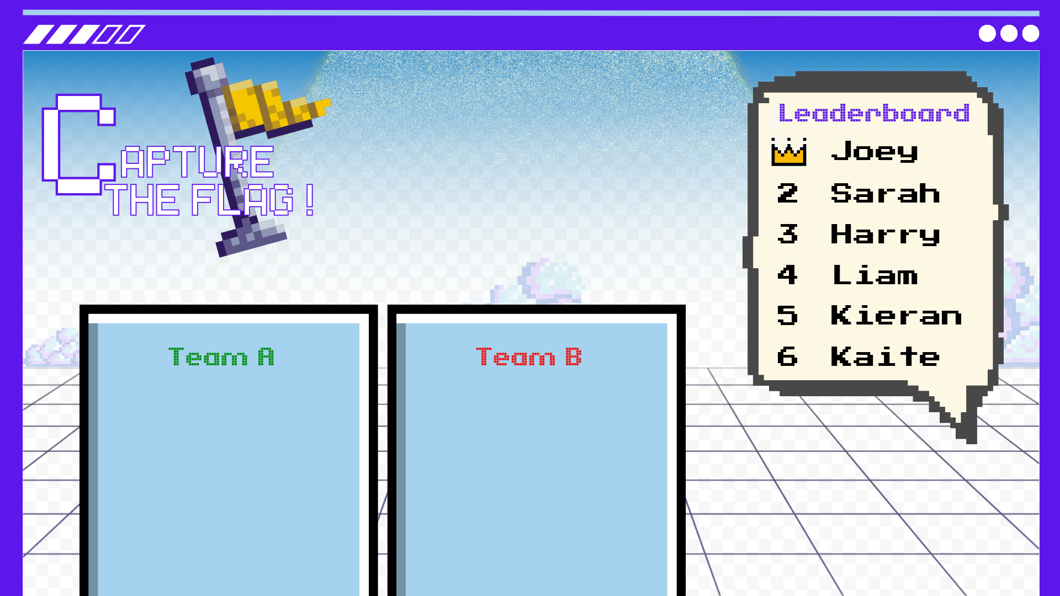
Earlier UI concept (a simplified mockup)

Slide 14
UI Design (Refined Vision)
Refined UI represents a design vision
Introduces planned features:
Start / Reset controls
Match timer (e.g. 60 seconds)
Stamina system
Central game area
Clear zoning for gameplay, controls, and feedback
Intended to guide Semester 2 development and final product

Slide 15
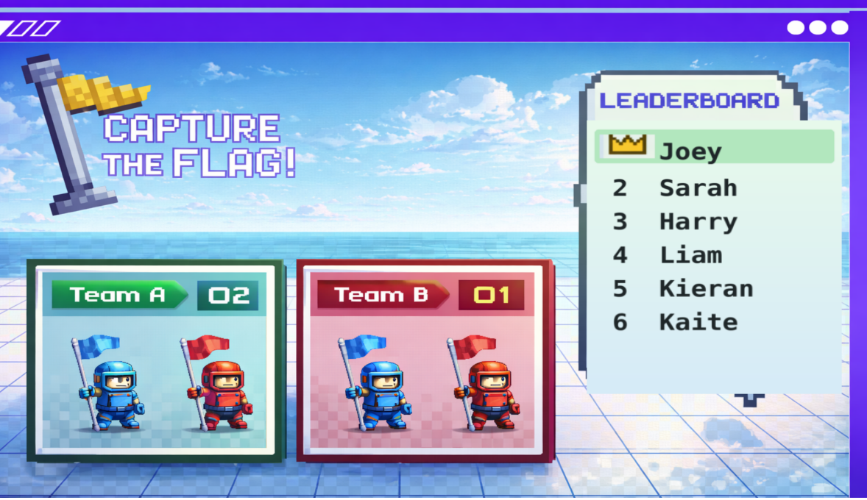
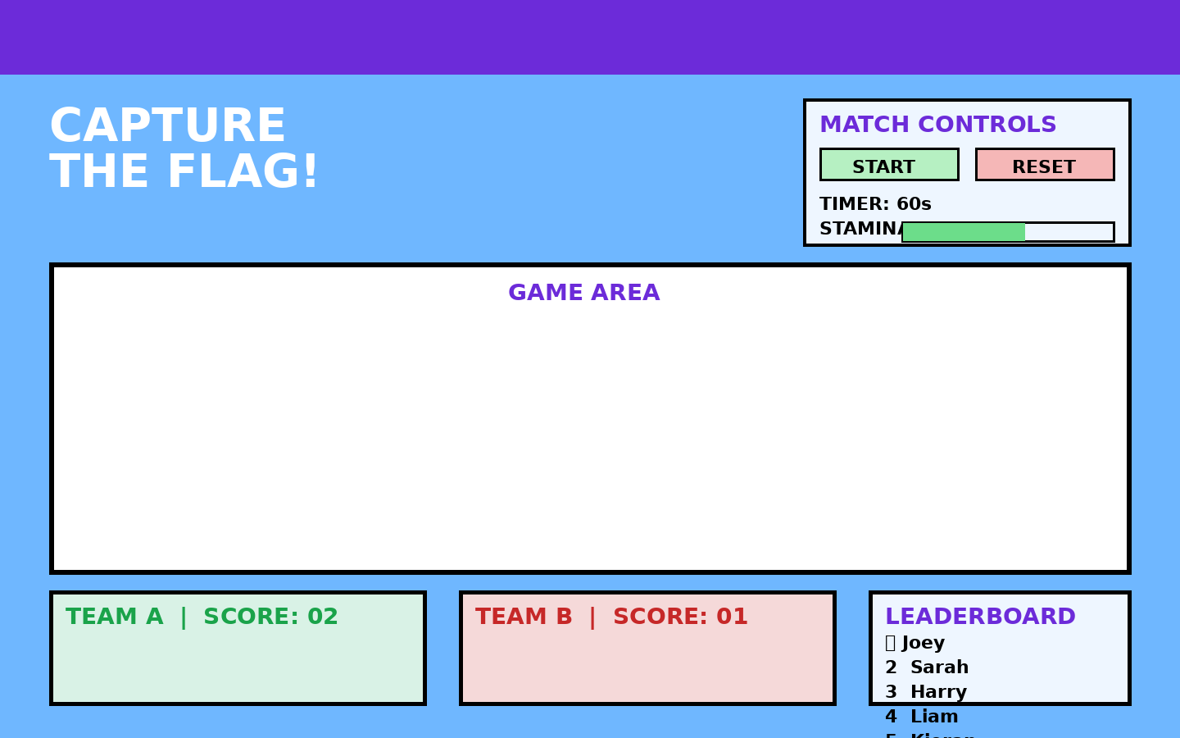
Clean refined UI concept image

Slide 16
Technical Direction
Software & Implementation Approach
HTML – main website framework and UI
Unity – embedded mini-games
Web service – hosted initially on university servers
AWS – planned final hosting solution
Database – store user statistics (playtime, accuracy)
Designed to run on low-spec school hardware

Slide 17
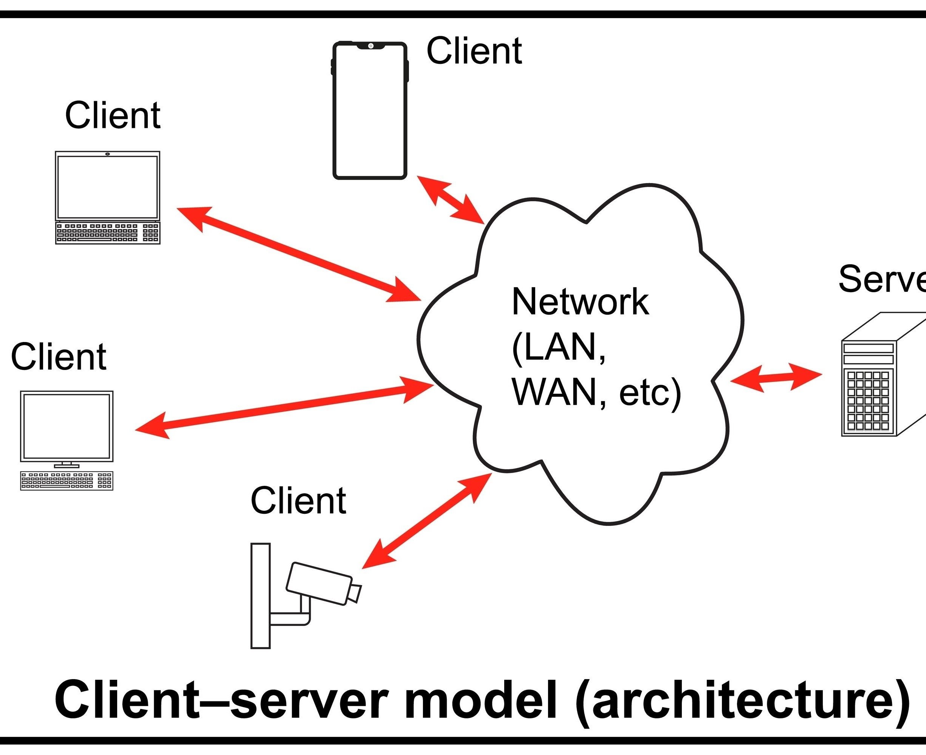
Data Architecture & Management
Core Requirements: System must be “Private” and “Managed”
What we store:
Usernames and passwords only
No personal student IDs or real names
Game Data: Tracks playtime, accuracy, and “flags” captured
Management: Full access for the client to view progress without developer help (CRUD)
Notes:
For the data section, I focused on the specific requirements listed in our proposal: the system needs to be 'Private' and 'Managed.' Since we are dealing with students, privacy is our biggest priority. I designed the database structure to be strictly separated. We store usernames and game statistics like accuracy and flags captured, but we deliberately do not store personal data like real names or student IDs. This minimizes risk.
We also ensured the system is 'Managed.' This means we implemented what are called CRUD operations—Create, Read, Update, Delete. This allows our client, Rory, to manage users and view student progress on his own, without needing to call us developers every time he wants to see a score.“
We have used CRUD operations for our two previous assignment as well which helps us with the development of this.

Slide 18
Security & Hosting
Security priority: Protecting pupils and school networks
Hosting Phase 1 (Testing):
Hosted locally on university of Plymouth servers
Hosting Phase 2 (Live):
Migration to AWS
Ensures the service is “available” and “flexible”
Budget: AWS chosen for its free tier option
Notes:
As the security lead, my main goal was meeting the 'Secure' requirement outlined in the brief. Because our target audience is minors aged 14 to 16, we have a responsibility to ensure the application is 'sandboxed' so it cannot threaten a school's internal network.
For hosting, we have a two-stage plan. Right now, during development, we are planning to host on University of Plymouth servers once the initial prototype is finished. This will be on the second of February where it'll work for one user. This keeps our testing environment safe.
However, for the final product, we plan to migrate to AWS. This hits two requirements from our proposal: it makes the game 'Available' anywhere without a VPN, and it fits our 'Budget' requirement because we can utilize the AWS free tier to keep costs at zero.

Slide 19
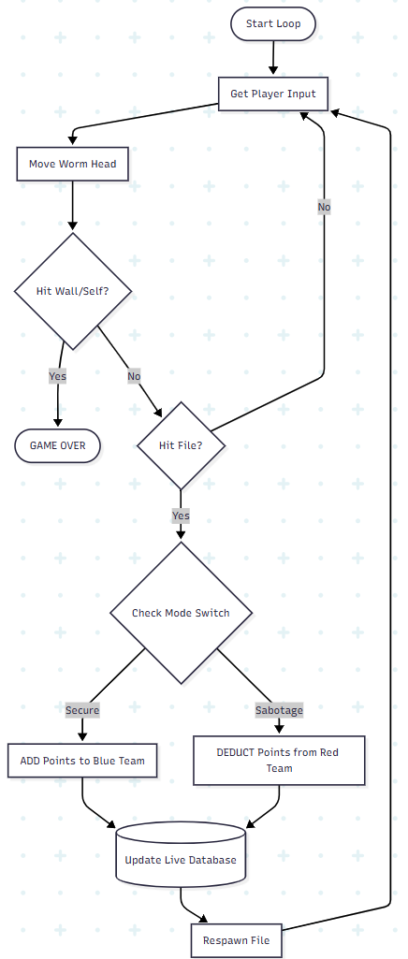
Logic Implementation
The Concept: The proposal requested a feature to "apply penalties to the opposing team" to create competitive interaction.
Core Feature: Implements the specific requirement to "apply penalties to the opposing team" (Sabotage).
Development Process:
Prototyped full game logic in HTML/JS first.
Validated the "Choice System" (Points vs. Sabotage) before Marc integrated it into Unity.
Outcome: A functional retro-style game that interacts directly with the live scoreboard.
Notes:
For the logic implementation, I focused on a specific gameplay requirement from our proposal: the need to 'apply penalties to the opposing team' or 'send difficult scenarios' to slow them down. To solve this, I designed the 'Cyber Worm' game.
Since Marc is handling the Unity engine and physics, I didn't want to waste time building features that might break the build. Instead, I created a rapid prototype using HTML and JavaScript first. This allowed me to write and test the specific code for how the worm grows and, more importantly, how it accesses the database to damage the enemy team's score.
By proving this logic worked in a web prototype first, it provided a clear outline for the team going forward. We knew the maths for deducting points was solid, making the final integration into the main Unity project much easier.“
This is currently in progress in unity up to date with our current timeline.

Slide 20
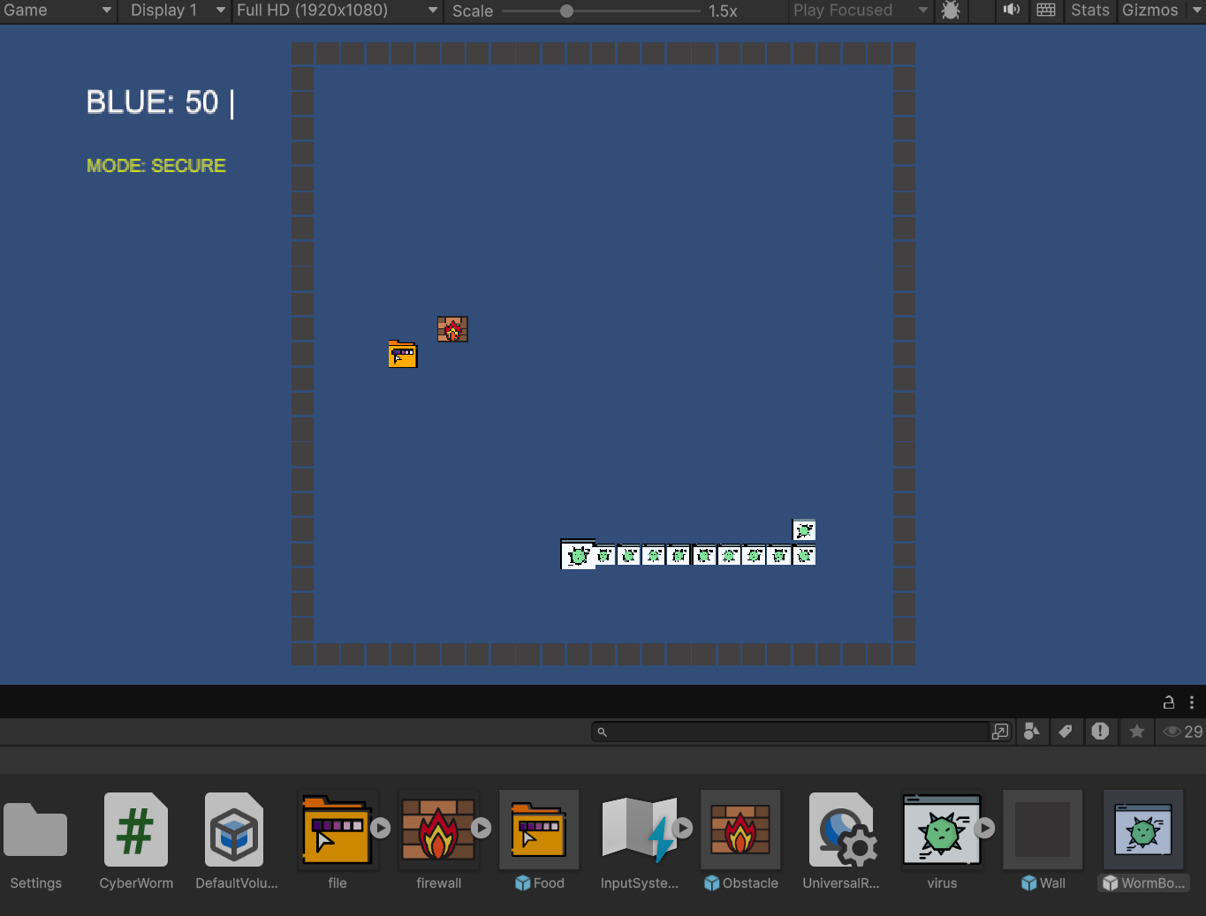
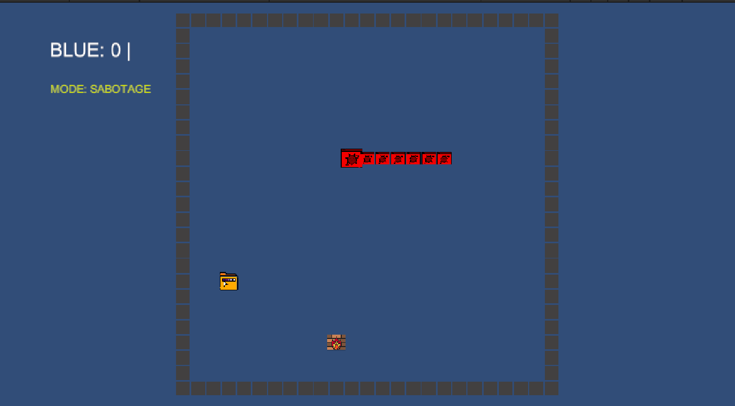
Ed’s Cyber Worm Game
Secure the data
Hack the files
Evade the firewalls
Notes:
I wanted to get a serious headstart on the coding risks, so I challenged myself to learn Unity from scratch and built a functional engine that simulates a worm virus spreading through a system. Being my worm game that I've planned out in previous sprints.
Currently, you control an infected file that collects data in "Secure Mode," but pressing Spacebar triggers "Sabotage Mode," flipping the code so you can attack the enemy score instead.
My future plan is to evolve the visuals into a full worm with a moving head, body, and tail, but getting this physics and logic system running on my own was a huge amount of work for this early stage of development.

Slide 21
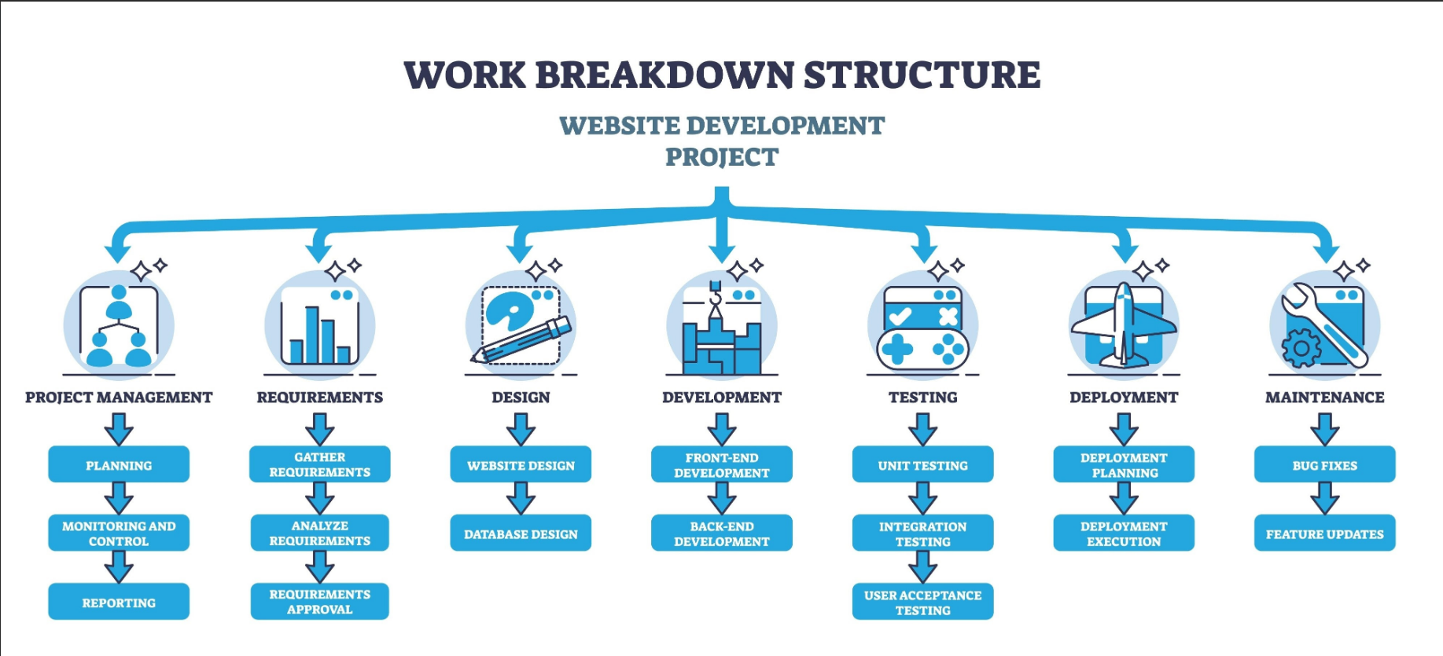
Web Architecture & Structure Development
The Backbone: A robust HTML5 framework serves as the container for all game elements.
Directory Structure:
Standardized file organization (CSS, Scripts, Assets) to allow multiple developers to work without conflicts
Modular Design: Each page (Lobby, Quiz, Mini-Game) is built as a separate module for easy maintenance
Unity Integration: Implementing a specific "WebGL Container" to embed Unity games directly into the web interface, ensuring a seamless transition for the user.

Slide 22
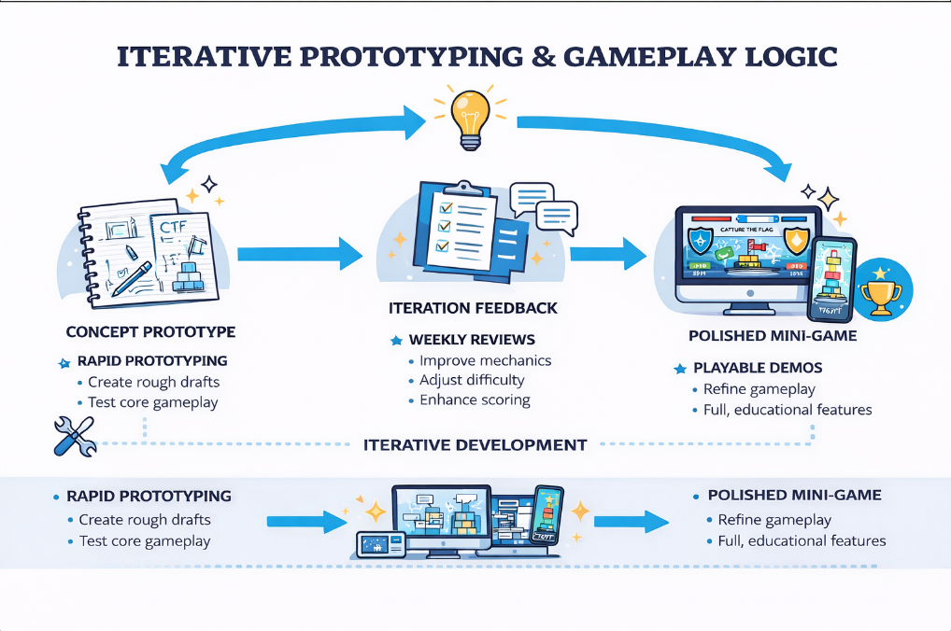
Iterative Prototyping & Gameplay Logic
From Concept to Playable Demonstrations
Rapid prototyping used to turn ideas into fully playable mini-games
Focus on core gameplay loops rather than visual polish
Early builds used to test:
- Player engagement
- Scoring logic
- Difficulty balance
Feedback-Driven Development
Prototypes reviewed during weekly meetings
Game mechanics refined based on:
-Team feedback
- Client-approved brief changes
Ensured mini-games remained educational, competitive, and accessible
Reusable Game Logic
Gameplay systems are designed to be reused or adapted
Supports future mini-games without rebuilding mechanics from scratch

Slide 23
Integration, Scalability & Maintainability
The "Hub" Concept: The HTML structure acts as the central hub linking:
The Database (Backend/Scores).
The Game Engine (Unity Mini-games).
The UI (User Interface).
Scalability:
The structure supports "Any number of players" by using lightweight web calls.
Designed to scale from small workshops to full-class sessions without code changes.
Maintainability:
Modular structure makes debugging and updates quicker
Individual components can be tested independently
Easier handover if new developers join the project

Slide 24
Next Steps
Semester 1 focused on concept, design, and planning
Semester 2 will focus on:
Implementing questionnaires and AI logic
Developing and integrating more mini-games
Expanding multiplayer and host controls
Testing and refinement

Slide 25
Conclusion
Client has reviewed and approved the current direction for the project. Semester 1 established a clear and adaptable system design that will guide implementation and refinement in Semester 2 and the final product. Throughout this semester clear design and system vision has been established.

